Slide 1
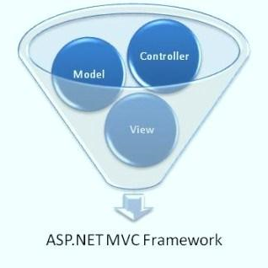


ASP.NET MVC Course
ASP.NET MVC Course Program, Evaluation, Exams
Nikolay Kostov
Team Lead, Senior Developer and Trainer
http://Nikolay.IT
Telerik Software Academy
academy.telerik.com

Slide 2

Table of Contents
What's Coming Next in the Academy?
The ASP.NET MVC Course Program
The Trainers Team
Exams and Evaluation
Standard Criteria
Bonuses
Resources for the Course
Champions from previous courses

Slide 3

ASP.NET MVC
Coming To The Next Module

Slide 4
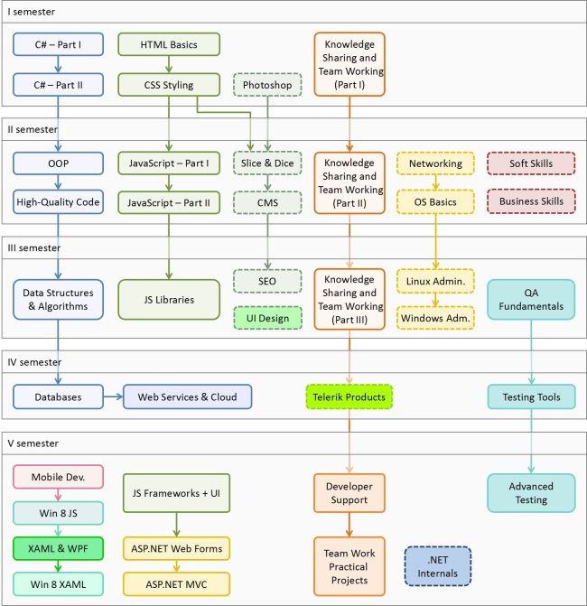

C# Programming Track
Software Academy Curriculum
Specialties @ the Academy
Success Stories @ Telerik

Slide 5

ASP.NET MVC – Program
What Will We Cover in the ASP.NET MVC Course?

Slide 6


ASP.NET MVC Course Program
Introduction to ASP.NET MVC
ASP.NET MVC Essentials
Kendo UI ASP.NET MVC Wrappers
Working with Data
AJAX in ASP.NET MVC
SignalR
ASP.NET MVC Advanced Topics
Web Security and ASP.NET
Teamwork and Exam

Slide 7
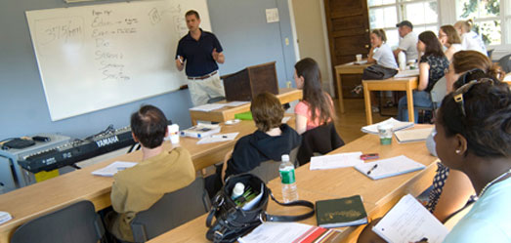
The Trainers Team

Slide 8
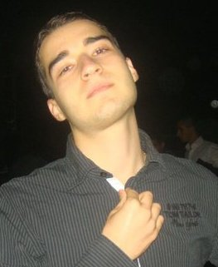
Trainers Team
Nikolay Kostov
Team Lead, Senior Developer and Trainer @ Telerik Corp.
Student in Sofia University
Computer Science
IT and Informatics competitions contestant
Graduate from the second season of Telerik Software Academy
Email: nikolay.kostov [at] telerik.com
Blog: http://nikolay.it

Slide 9
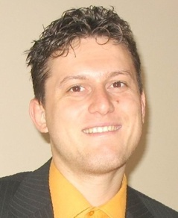
Trainers Team (2)
Svetlin Nakov, PhD
Manager Technical Training @ Telerik Software Academy
20 years software development experience
10+ years experience as trainer
Author of 6 books
Speaker at hundreds of events
E-mail: svetlin.nakov [at] telerik.com
Web site / Blog: http://nakov.com

Slide 10
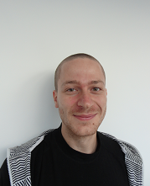
Trainers Team (3)
Ivaylo Kenov
Technical Trainer @ Telerik Corp.
Student at Telerik Academy Season 2012/2013
Mathematical competitions contestant
E-mail: ivaylo.kenov [at] telerik.com
Champion in OOP and DSA

Slide 11





Evaluation
Thank God There Are Bonuses!

Slide 12

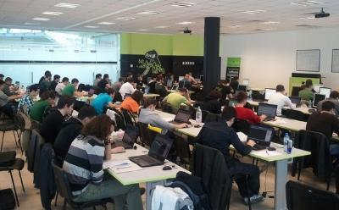
ASP.NET MVC – Evaluation
Evaluation components
Practical exam – 65%
Peer review – 8 exams
Teamwork – 10%
Homework – 10%
Homework evaluation – 5%
3 peer reviews per homework (excellent, OK, bad)
Attendance in class – 10%
Bonuses
Forums activity – bonus up to 5%

Slide 13


Pass / Excellence / Fail Criteria
Criteria for pass / pass with excellence / fail
Pass with excellence
Very high exam results
or
High total results
Pass
Average total results
Fail
Low total results or low exam results

Slide 14
Homework Peer Reviews
Everyone will get feedback for their homework
Everyone will give feedback for few random homework submissions
Students submit homework anonymously
Please exclude your name from the submissions!
For each homework submitted
Students evaluate 3 random homeworks
From the same topic, after the deadline
Homework comments are not obligatory

Slide 15
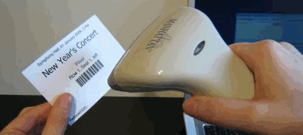
Check Your Presence
From now on you should check your presence on the barcode reader 3 times a day:
In the morning when lectures begin (~10:30)
After lunch break (~13:30)
When you leave academy halls (~18:00)

Slide 16








Resources
What We Need in Addition to this Course Content?

Slide 17

Course Web Site & Forums
Register for the "Telerik Academy Forums":
Discuss the course exercises with your colleagues
Find solutions for the exercises
Share source code / discuss ideas
The ASP.NET MVC official web site:
http://forums.academy.telerik.com/web-development/asp-net-mvc
http://academy.telerik.com/student-courses/software-technologies/aspnet-mvc/about

Slide 18
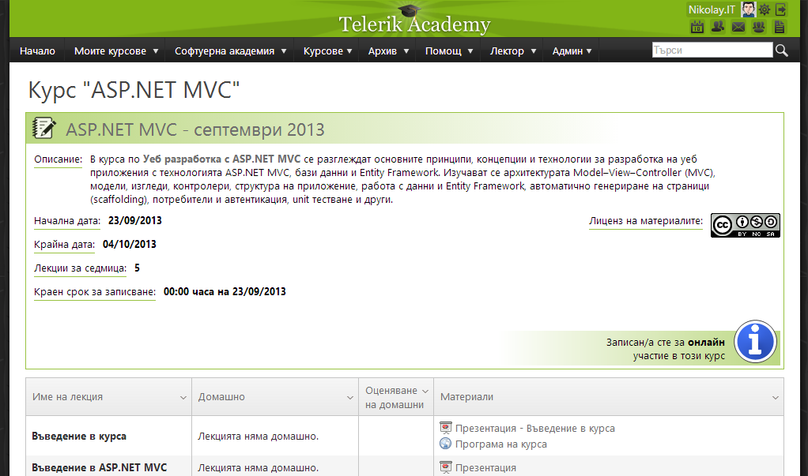
Telerik Academy Learning System
The Telerik Academy Learning System
www.telerikacademy.com
Important resource for all students
Homework submissions
Homework peer reviews
Presence cards with barcode
Reports about your results
telerikacademy.com/Courses/Courses/Details/112

Slide 19


Required Software
Software needed for this course:
Microsoft Windows (Win7 / Win8)
Microsoft Visual Studio 2013 RC
.NET Framework 4.5 (included in Visual Studio)
Microsoft SQL Server 2012 + Developer Tools
Web browser with developer tools

Slide 20


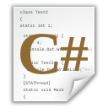
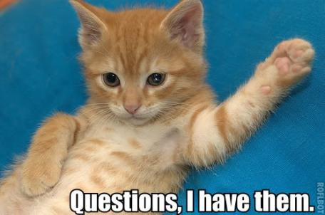

ASP.NET MVC: Course Introduction
http://academy.telerik.com

Slide 21




Free Trainings @ Telerik Academy
C# Programming @ Telerik Academy
csharpfundamentals.telerik.com
Telerik Software Academy
academy.telerik.com
Telerik Academy @ Facebook
facebook.com/TelerikAcademy
Telerik Software Academy Forums
forums.academy.telerik.com

